Slide 1

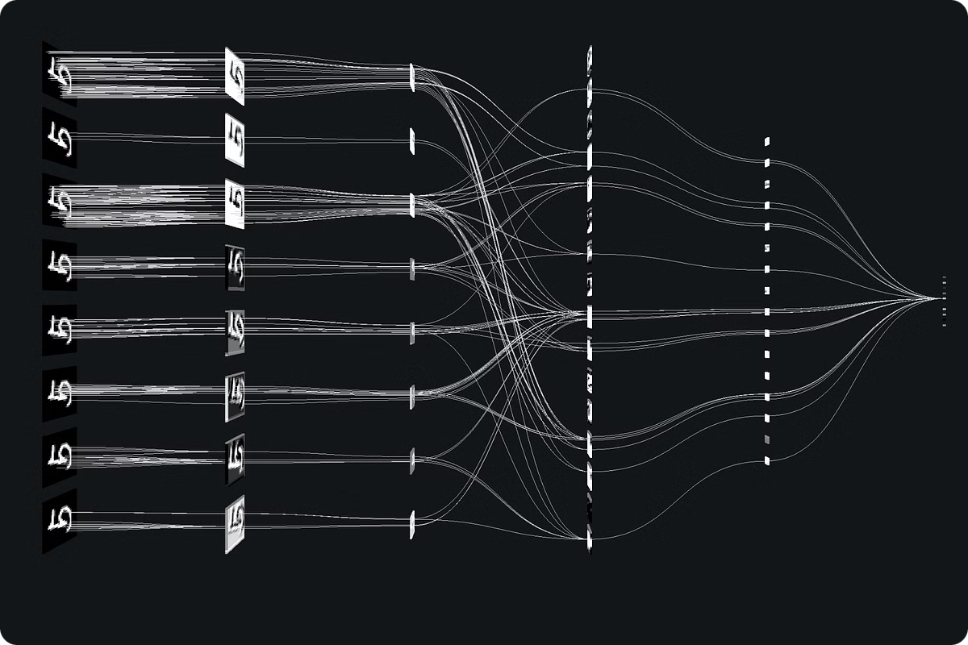
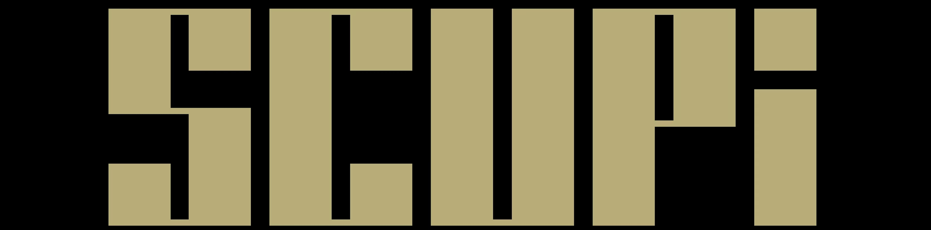
Application of ResNet in Skin Disease Diagnosis
An Introduction to Residual Networks in Deep Learning
Presented by Sebastian Shuai & Dame Chen
November 11, 2024

Slide 2

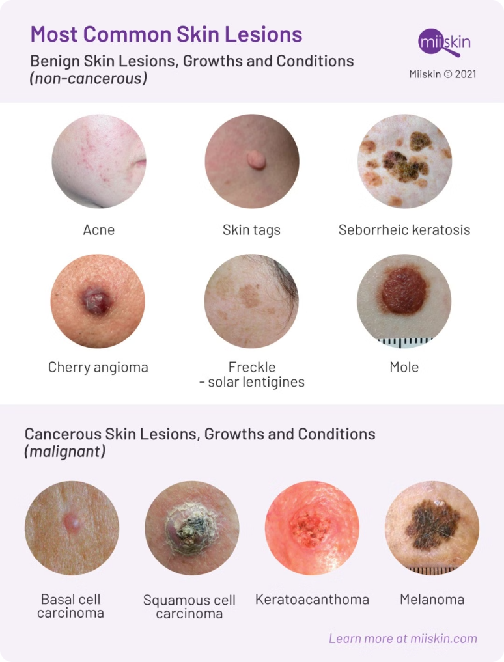
Background of Skin Disease Diagnosis
1
Introduction to Skin Disease Diagnosis
2
Importance of Accurate Diagnosis
Skin disease diagnosis is a challenging task due to the variability and complexity of skin lesions.
Early and accurate diagnosis is crucial for effective treatment and management of skin diseases.
3
Current Challenges
4
Role of Deep Learning
Variability: Different skin conditions can have similar symptoms. Complexity: Lesions can vary in size, shape, color, and texture. Human Error: Manual diagnosis by dermatologists can be subjective and error-prone.
Deep learning models, particularly Convolutional Neural Networks (CNNs), have shown promise in automating and improving the accuracy of skin disease diagnosis.

Slide 3
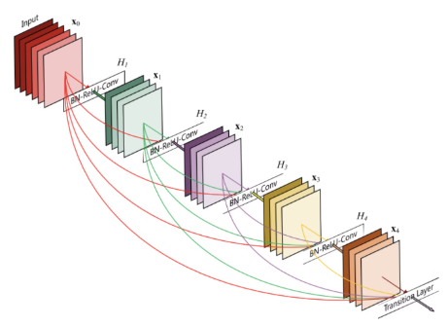
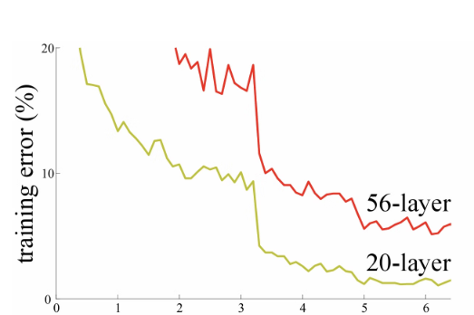
Why Introduce ResNet?
——There are 2 Problems in Traditional CNNs
What is ResNet?
Problem 1: Overfitting
A model performs well on training data but poorly on unseen test data.
ResNet (Residual Network) is a type of deep convolutional neural network introduced by Kaiming He et al. in 2015. It addresses the vanishing gradient problem and allows the training of much deeper networks.
Example: A deep CNN trained on a small dataset. As the network gets deeper from 20 layers to 56 layers, it starts to overfit, meaning it performs well on the training data but fails to generalize to new data.
Analogy: Just like a student who has memorized many practice problems but struggles with original exam questions, a model that overfits performs well on seen data but poorly on new data.

Slide 4

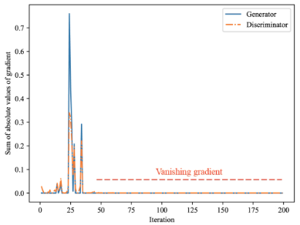
Problem 2: Vanishing Gradient
Definition
In deep networks, gradients can become so small during backpropagation that they effectively vanish, making it difficult to train the network.
Example
A 3-layer neural network Example
For a 3-layer neural network, the gradient of the loss function L with respect to the input x can be expressed as:
Expanding this, we get:

Slide 5
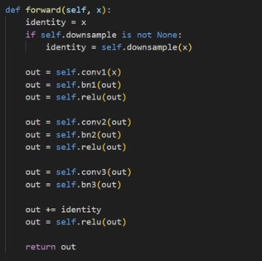
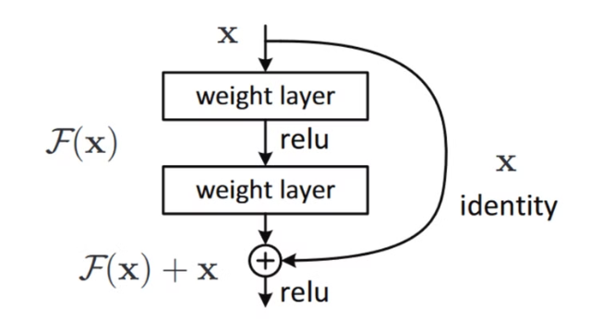
ResNet Architecture Explained - Basic Concepts
Basic Formula
Identity Mapping
Activation Function
Explanation: In this formula, yl is the output, F(xl, Wl) is the output of the stacked layers, and xl is the input. By adding the input xl directly to the output of the stacked layers F(xl, Wl), ResNet creates a shortcut that helps preserve the gradient information.
Explanation: The identity mapping ensures that the input xl is directly added to the output of the residual function F(xl, Wl).
Explanation: The activation function f (typically ReLU) is applied after the addition to introduce non-linearity.

Slide 6
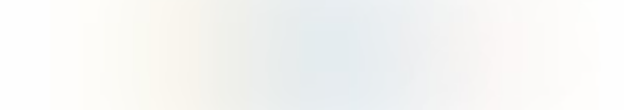
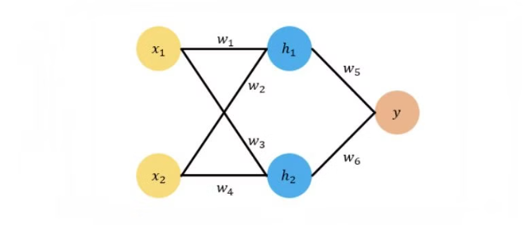


Forward and Backward Propagation in ResNet
Forward Propagation
Backward Propagation
Explanation: The feature xL of any deeper unit L can be represented as the sum of the input feature xl of any shallower unit l and the outputs of all intermediate residual functions.
Explanation: The gradient ∂E/∂xl can be decomposed into two terms: a direct term that propagates information without concerning any weight layers, and another term that propagates through the weight layers.

Slide 7
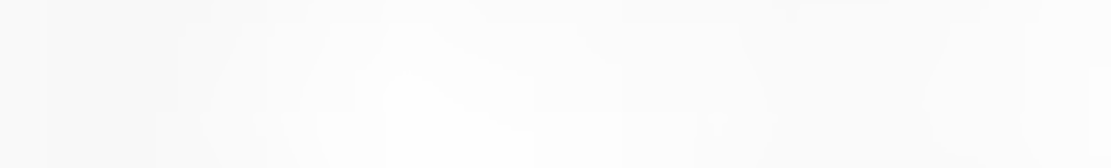
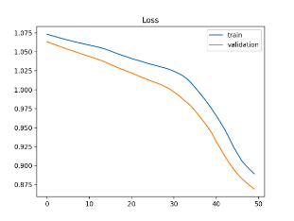
How well ResNet Help Skin Disease Diagnosis and improve Performance
Improved Training Efficiency:
Skip connections help in alleviating the vanishing gradient problem.
Enhanced Model Performance:
Comparison table showing performance improvements over traditional CNNs
using ISIC(international skin imaging collaboration) dataset)
Metric
ResNet
Traditional Methods
Accuracy
95%
85-90%
Sensitivity
93%
N/A
Specificity
97%
N/A

Slide 8


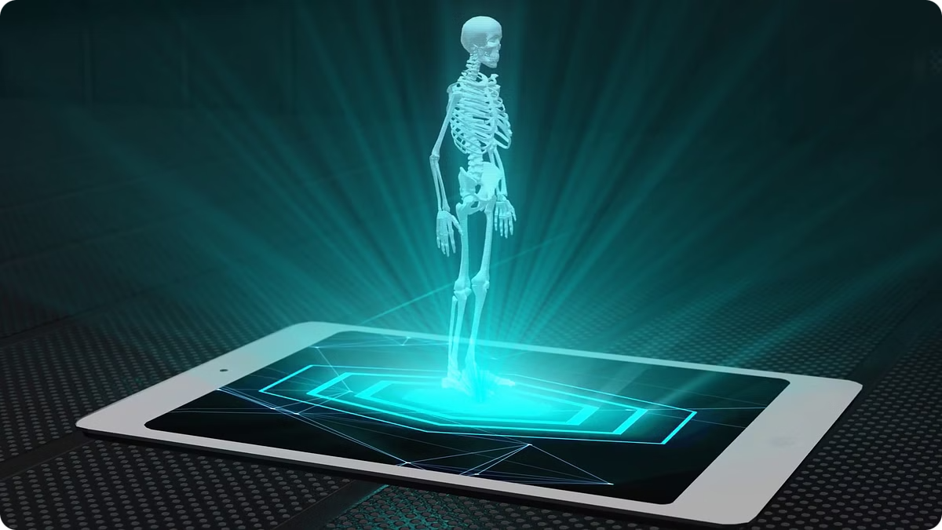


Future Applications of ResNet
Medical Imaging
Detection and segmentation tasks.
Autonomous Driving
Object recognition and scene understanding.
Combining Residual Networks with Other Models
Natural language processing, etc.

Slide 9

Questions & Answers
References
He, K., Zhang, X., Ren, S., & Sun, J. (2016). Deep residual learning for image recognition. In Proceedings of the IEEE Conference on Computer Vision and Pattern Recognition.
He, K., Zhang, X., Ren, S., & Sun, J. (2016). Identity mappings in deep residual networks. In European Conference on Computer Vision.
Xu, W., Fu, Y.-L., & Zhu, D. (2023). ResNet and its application to medical image processing: Research progress and challenges. Computer Methods and Programs in Biomedicine.

